Slide 1
Projection of the extent of inundation corresponding to the forecasts of flood levels in a river.
CSE7101- Capstone Project
Review-1
Batch Number: CSE_131
Roll Number
20221CSE0525 HAMSA M
20221CSE0499 BHAGYASHREE N PATIL 20221CSE0526 AY HARSHITHA
Under the Supervision of,
MR.LIKHITH S.R
Assistant Professor
School of Computer Science and Engineering
Presidency University
Name of the Program: B.TECH
Name of the HoD: DR.ASIF MOHAMMED
Name of the Program Project Coordinator: DR.JAYAVADIVEL RAVI
Name of the School Project Coordinators: Dr. Sampath A K , Dr. Geetha A

Slide 2
Problem Statement Number:PSCS_6
Organization: Department of Computer Science and Engineering,
Presidency University Bangalore
Category (Hardware / Software / Both) :Software
Problem Description: Floods are one of the most destructive natural disasters, causing loss of lives, damage to infrastructure, and economic setbacks.
Traditional prediction methods often lack accuracy and timeliness. This project uses machine learning with multi-source data—rainfall, river levels, temperature, and satellite imagery—to provide accurate, real-time flood forecasts for better preparedness and response.

Slide 3
Content
Problem Statement
Objectives
Background and Related work for title Selection
Analysis of Problem Statement
Innovation or Novel Contributions
Git-hub Link
Timeline of the Project
References

Slide 4
Analysis of Problem Statement
Technology Stack Components:
Programming Language: Python
Machine Learning Libraries: Scikit-learn, Pandas, NumPy.
Visualization: Matplotlib,confusion matrix,classification report.
APIs & Data Sources: OpenWeather API, Insat Satellite Data Sources.
Tools & Platforms: Google Colab / Jupyter Notebook, Flask or Django for backend API development.
Software Requirements: Python, TensorFlow, Flask, MongoDB

Slide 5
objectives
To collect and preprocess diverse flood-related datasets, including rainfall, river water levels, temperature, and historical flood records.
To analyse and evaluate model performance based on accuracy, precision, and recall to determine the most effective approach.
To develop a real-time flood forecasting system capable of providing early warnings for high-risk areas.

Slide 6
Analysis of Problem Statement (contd...)
Traditional flood forecasting models lack adaptability, accuracy, and scalability due to dependence on limited historical and meteorological data.
This project overcomes these limitations by integrating multi-source data (rainfall, river levels, temperature, satellite imagery) with machine learning models like XGBoost and K-Means for real-time, high-accuracy predictions.
It also includes risk categorization (low, medium, high) and can integrate with disaster management systems for timely alerts.

Slide 7
Analysis of Problem Statement (contd...)
"Floods cause severe damage to life and property. Lack of accurate inundation prediction delays evacuation and disaster response. A system using satellite imagery and machine learning can forecast flood extent, aiding timely action and reducing losses.“
Expected outcome:
Accurate and timely prediction of flood-affected areas.
Reduced loss of life and property through early warnings.
Better resource allocation for emergency response teams.

Slide 8
Github Link
GITHUB REPOSITORY LINK:
https://github.com/harshitha101831/Batch-number_131/upload

Slide 9
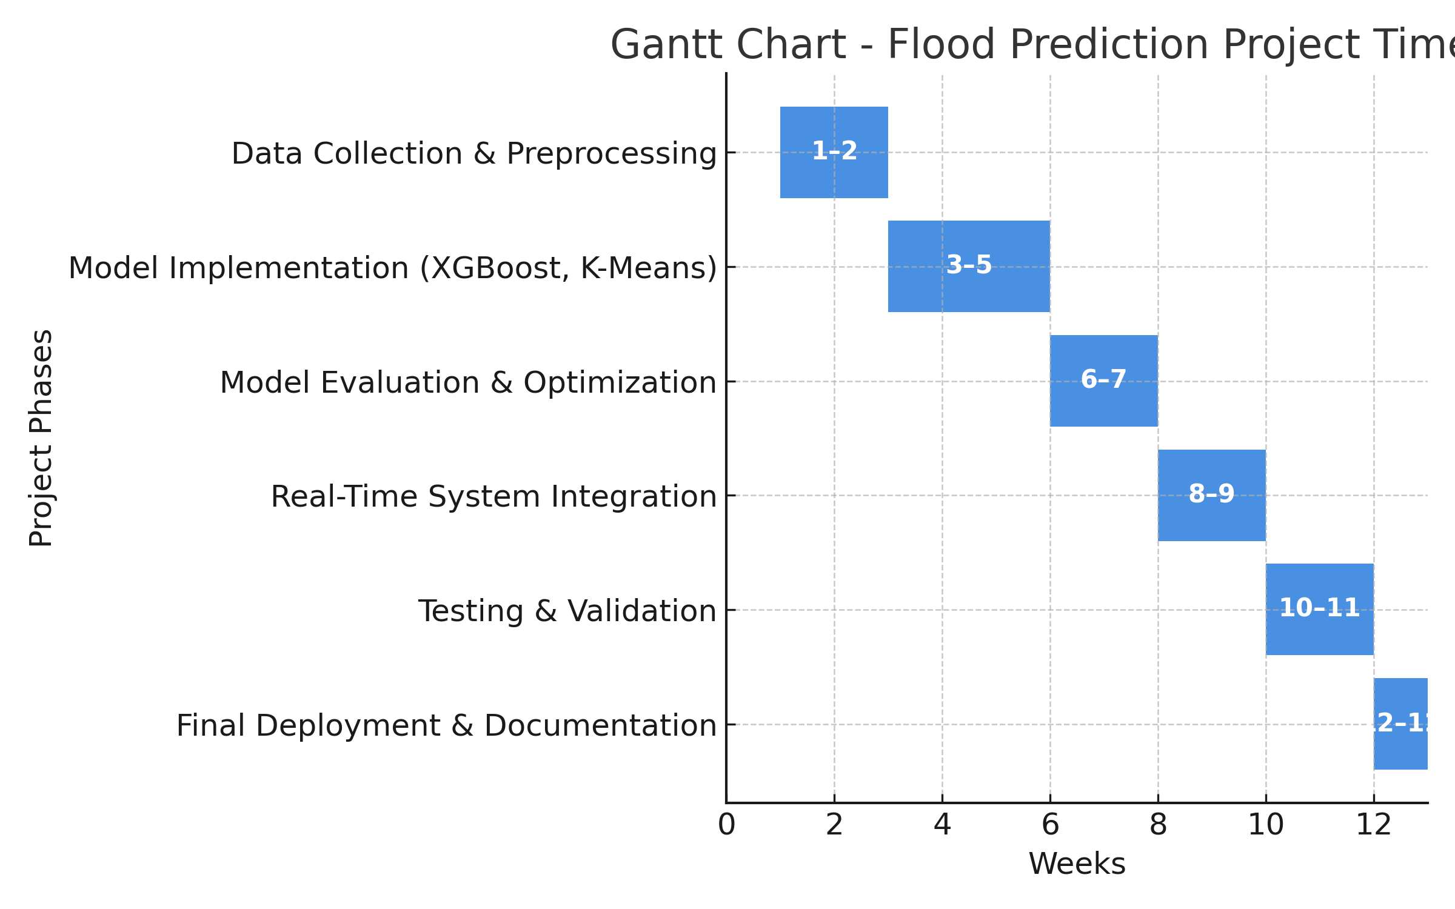
Timeline of the Project (Gantt Chart)

Slide 10
References (IEEE Paper format)
  [1] G. Schumann, P. Bates, M. Pappenberger, A. J. Smith, P. B. de Roo, and Y. Yamazaki, “Advances in flood modelling and monitoring,” Progress in Physical Geography.
  [2] C. Nevo and E. Shamir, “A systematic approach to flood forecasting in real-time,” Water

Slide 11


